Slide 1
CAPSTONE PROJECT
TELECOM CHURN PREDICTION BY DATA SCIENCE
Presented By:
1. S.PRASANNA-Alagappa college of technology,Chennai- Ceramic technology

Slide 2
OUTLINE
Problem Statement
Proposed System/Solution
System Development Approach
Algorithm & Deployment
Result
Conclusion
Future Scope
References

Slide 3
PROBLEM STATEMENT
Telecom companies face challenges with customer churn impacting revenue. Data analytics helps predict churn by collecting and preprocessing data, engineering features, building predictive models, and deploying them for real-time predictions. Implemented retention strategies based on predictions to reduce churn rates and optimize business growth

Slide 4
PROPOSED SOLUTION
Utilizing advanced machine learning algorithms, our solution will analyze extensive historical hotel booking data to establish patterns and correlations.
For optimal timing, a predictive model will consider factors such as seasonality, demand fluctuations, and promotional periods, providing users with insights on when to secure the most cost-effective room rates.
The ideal length of stay will be determined through data-driven analysis, considering variables like day-of- week trends and duration-specific pricing strategies
This holistic approach aims to empower travelers and hoteliers alike with actionable intelligence for strategic decision-making in the dynamic hospitality landscape.

Slide 5
SYSTEM APPROACH
Building the proposed solution would involve a combination of data processing, feature engineering, and machine learning. Here are the key system and library requirements:
System Requirements:
Hardware:
A computer with sufficient processing power, preferably with multiple cores or a GPU for faster training of machine learning models.- Adequate RAM to handle the size of the dataset and computational requirements.
Software:-
An operating system compatible with the required machine learning libraries (e.g., Windows, Linux, macOS).

Slide 6
Library Requirements:
1.Data Processing and Analysis:-
Pandas: For data manipulation and analysis
NumPy: For numerical operations on data.
2. Data Visualization:-
Matplotlib and Seaborn: For creating visualizations to understand data patterns.
Plotly or Bokeh: Interactive visualization libraries for more complex visualizations.

Slide 7
ALGORITHM & DEPLOYMENT
Algorithm:
One common algorithm for telecom churn prediction is the Random Forest classifier. This ensemble learning method combines multiple decision trees to make predictions. Here's a simplified outline of the algorithm:
1.Data Preprocessing: Clean the dataset, handle missing values, encode categorical variables, and split the data into training and testing sets.
2. Feature Selection/Engineering: Identify relevant features that contribute to churn prediction. This may include customer demographics, usage patterns, contract details, and customer interactions.
3. Model Training: Train the Random Forest classifier using the training data. The algorithm builds multiple decision trees based on random subsets of features and data samples.
4. Model Evaluation: Evaluate the trained model using the testing data to assess its performance. Common evaluation metrics include accuracy, precision, recall, and F1-score.5.

Slide 8
Deployment Statement:
The deployment of the Random Forest churn prediction model involves the following steps:
1.Integration: Integrate the trained Random Forest model into the telecom company's existing infrastructure or applications. This could involve using APIs or libraries to enable seamless interaction between the model and other systems.
2. Scalability Ensure that the deployed model can handle the volume of incoming customer data in real-time or batch processing mode. This may involve deploying the model on scalable cloud infrastructure to accommodate fluctuations in workload.
3. Monitoring: Implement mechanisms to monitor the performance of the deployed model in production. This includes tracking prediction accuracy, response times, and any drift in model behavior over time.
4. Feedback Loop: Establish a feedback loop to gather data on the model's predictions and their outcomes. This information can be used to continuously evaluate and refine the model, improving its accuracy and effectiveness over time.
5. Documentation and Training:Document the deployment process and provide training to relevant stakeholders on how to interpret and use the model's predictions effectively in their decision-making processes.
By following these steps, the Random Forest churn prediction model can be successfully deployed in a telecom company's environment, enabling proactive retention efforts to reduce churn rates and improve customer satisfaction.

Slide 9
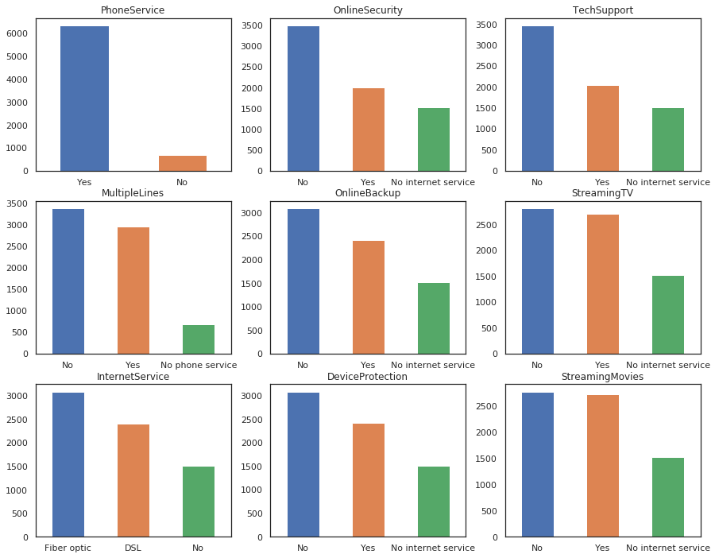
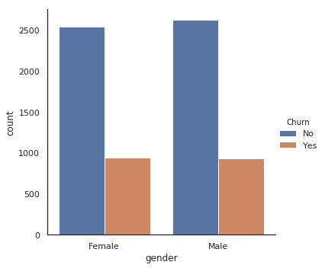
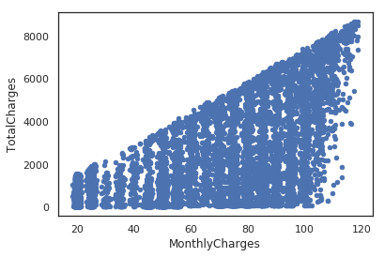
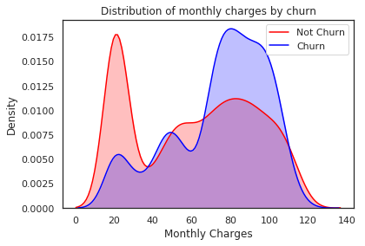
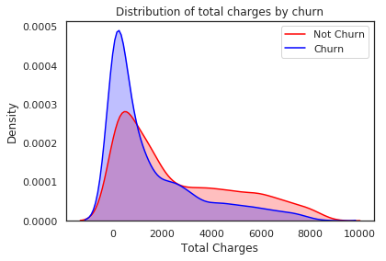
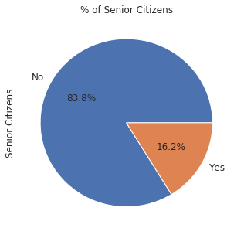
RESULT

Slide 10
CONCLUSION
In conclusion, our proposed solution for telecom churn prediction leverages advanced data preprocessing, feature engineering, and machine learning techniques to accurately identify customers at risk of churn. By deploying predictive models and an interactive dashboard for real-time monitoring, telecom companies can proactively implement retention strategies, leading to improved customer retention rates and sustained business growth

Slide 11
FUTURE SCOPE
The future scope for telecom churn prediction using data analytics is promising and includes several potential avenues for further development and enhancement:
1.Advanced Machine Learning Techniques: Explore more advanced machine learning techniques such as deep learning models (e.g., neural networks) to capture complex patterns in telecom data and improve churn prediction accuracy.
2.Real-time Predictions: Develop models and infrastructure capable of making real-time predictions to enable immediate intervention strategies and enhance customer retention efforts.
3. Predictive Analytics: Integrate additional data sources such as social media activity, customer feedback, and external factors (e.g., economic indicators) to enhance predictive analytics capabilities and provide a more comprehensive understanding of customer behavior.
4. Personalized Retention Strategies: Utilize predictive analytics to tailor retention strategies at an individual customer level, offering personalized incentives, discounts, or service upgrades based on predicted churn probabilities and customer preferences.

Slide 12
REFERENCES
https://www.kaggle.com
https://colab.research.google.com/?utm_source=scs-index

Slide 13
THANK YOU

